Slide 1
ENGLISH FOR MANAGEMENT
TALK ABOUT THEIR JOBS
01

Slide 2


How to describe and talk about your job
Work
Photo by iCipart

Slide 3
















What do you do? / What’s your job?
 I’m a firefighter.
 I
work
as
a
firefighter.
With jobs
we always use «a/an»

Slide 4








Where do you work?
 I’m in the financial sector.
 I work in a bank.

Slide 5







Who do you work for?
 I work for an airline company.
 I work for American Airlines.

Slide 6

















Working hours
 He has a full-time job, e.g. 40 hours a week.
 He has a part-time job, e.g.
15
hours
a
week.
 He works long hours, e.g. 12
hours a day.
 He works from nine to five.

Slide 7









How much do you earn?
 She earns a lot. Her salary
is $80,000 a year.
 He doesn’t earn much. He
gets low wages.

Slide 8




Now find a suitable word
 When you work for yourself and
not for a company, you are...
self-employed

Slide 9
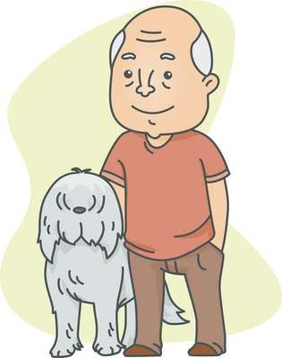

Now find a suitable word
 If you no longer work because
are over 65, you are...
you
retired

Slide 10


Now find a suitable word
 If
you are out of
work,
you
are...
unemployed

Slide 11


Now find a suitable word
 The person who tells people
to do in their jobs is the...
what
boss

Slide 12
ENJOY YOUR CONVERSATION

